Slide 1

Pre Practice Task

Slide 2
Data list
Titanic_sample
ID | File name | Overview
S01 | train.csv | Data on 722 Titanic passengers with survival information (You can use this data to create an AI)
S02 | test.csv | Data on 169 Titanic passengers with NO survival information (You can use this data for prediction)
S03 | answer.csv | Survival information in the test.csv (Answers in test.csv)
S04 | sample.ipynb | Sample of model creation and evaluation (python)
S05 | sample.xlsx | Sample of model creation and evaluation (Excel)
Task
ID | File name | Overview(Detail -> p.6)
T01 | train.csv | Data on 3,999 bank customers with information on time deposit application status
T02 | test.csv | Data on 522 bank customers with NO information on time deposit application status
T03 | submission_sample.csv | Sample files to be submitted

Slide 3

Flow of Model Creation
Titanic_sample
train.csv
Result of prediction
test.csv
answer.csv
X
y
Prediction Model
X
y
y
① Make
② Predict
③ Evaluation
(Comparison)
Task
X
y
X
y
① Make
② Predict
③ Submmission
(Your Task!!!)

Slide 4
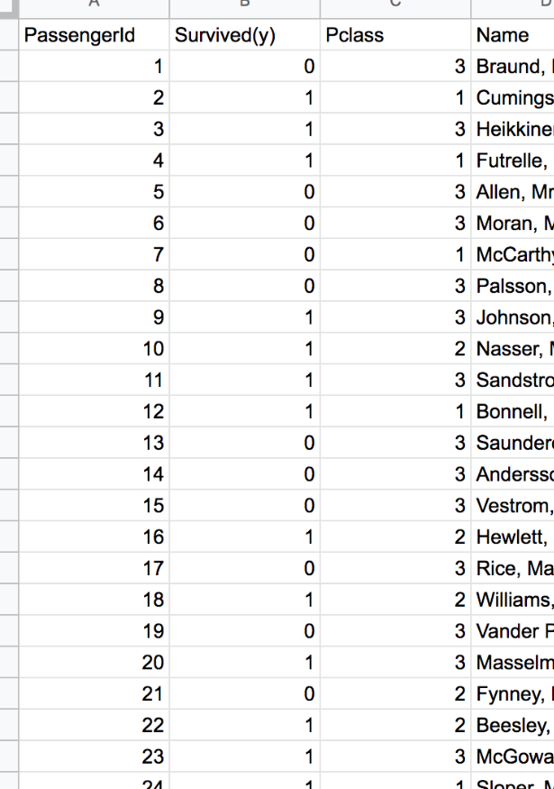
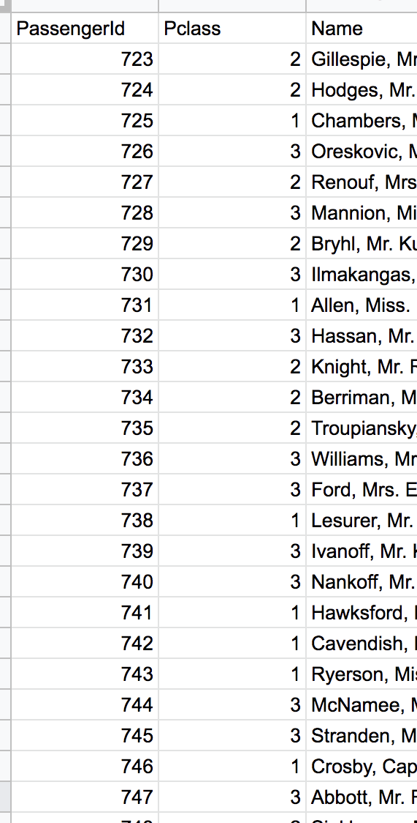
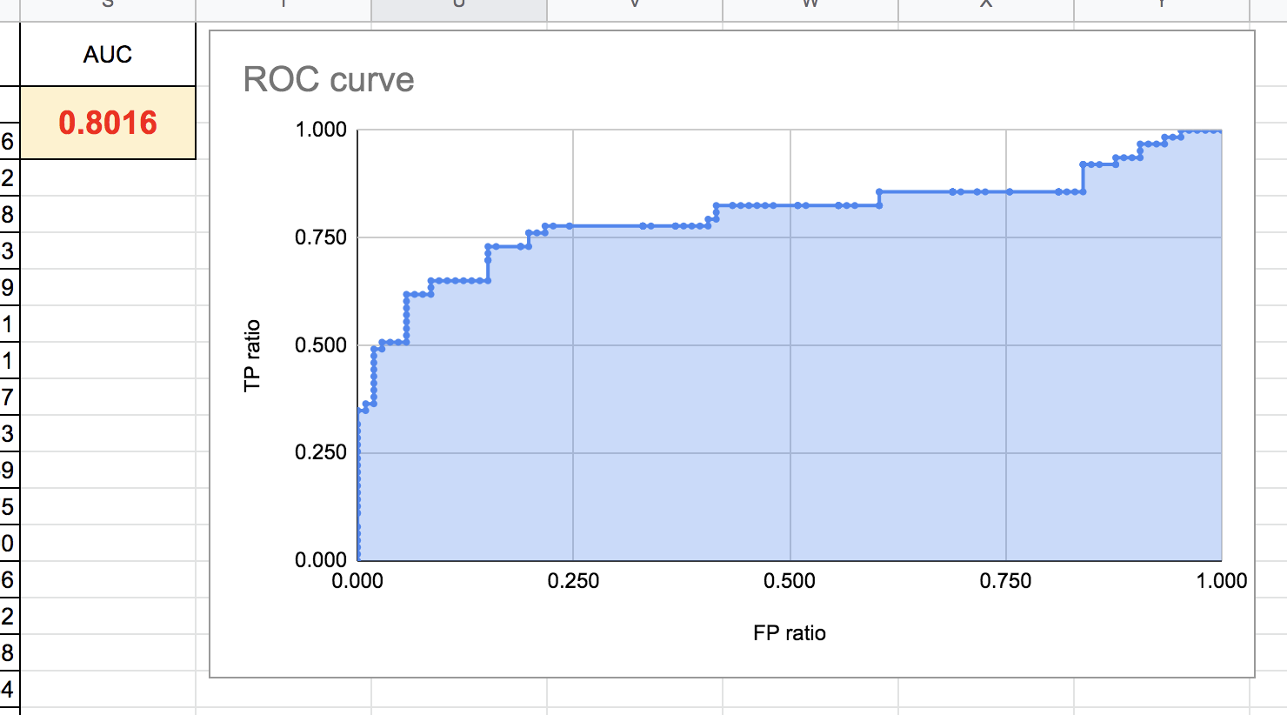
Overview of Titanic_sample (1/2)
Survivor data for the Titanic.
Create a model to predict "Survived(y)" (alive = 1, dead = 0).
Use AUC for evaluation (the closer to 1, the better).
sample.xlsx
Result of prediction
“train” sheet
“test” sheet
y
“evaluation” sheet
Evaluation
AUC is 0.8016
How can it be improved?

Slide 5
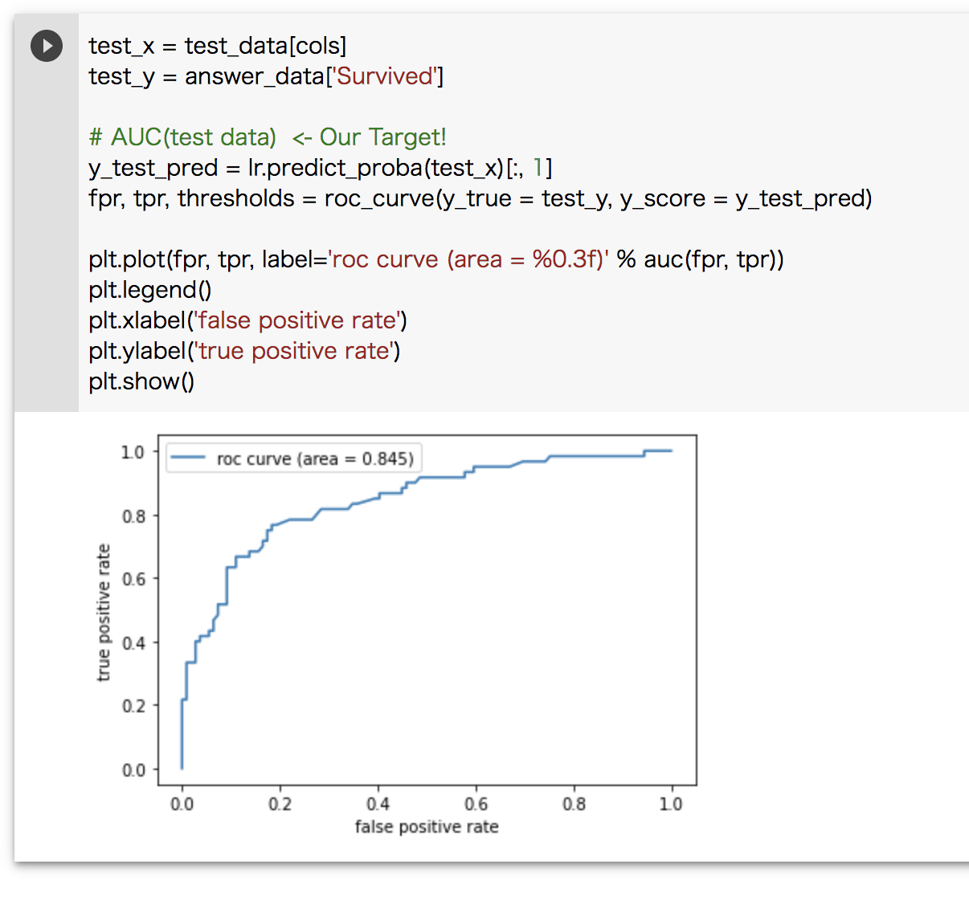
Overview of Titanic_sample (2/2)
You can do the exercises in python if you use sample.ipynb.
For more information on how to use python and other machine learning techniques, check the Internet.
sample.ipynb
AUC is 0.845
How can it be improved?

Slide 6
Overview of your task (1/2)
The data is related with direct marketing campaigns of a Portuguese banking institution. The marketing campaigns were based on phone calls.
The classification goal is to predict if the client will subscribe (yes/no) a term deposit (variable y). <- Your mission
Description of Variables:
loan | has personal loan? (categorical: 'no','yes','unknown')
contact | contact communication type (categorical: 'cellular','telephone')
month | last contact month of year (categorical: 'jan', 'feb', 'mar', ..., 'nov', 'dec')
duration | last contact duration, in seconds (numeric). Important note: this attribute highly affects the output target (e.g., if duration=0 then y='no'). Yet, the duration is not known before a call is performed. Also, after the end of the call y is obviously known. Thus, this input should only be included for benchmark purposes and should be discarded if the intention is to have a realistic predictive model.
campaign | number of contacts performed during this campaign and for this client (numeric, includes last contact)
pdays | number of days that passed by after the client was last contacted from a previous campaign (numeric; 999 means client was not previously contacted)
previous | number of contacts performed before this campaign and for this client (numeric)
poutcome | outcome of the previous marketing campaign (categorical: 'failure','nonexistent','success')
id | client id
age | (numeric)
job | type of job (categorical: 'admin.','blue-collar','entrepreneur','housemaid','management','retired','self-employed','services','student','technician','unemployed','unknown')
marital | marital status (categorical: 'divorced','married','single','unknown'; note: 'divorced' means divorced or widowed)
education | (categorical: 'basic.4y','basic.6y','basic.9y','high.school','illiterate','professional.course','university.degree','unknown')
default | has credit in default? (categorical: 'no','yes','unknown')
balance | (numeric)
housing | has housing loan? (categorical: 'no','yes','unknown')

Slide 7
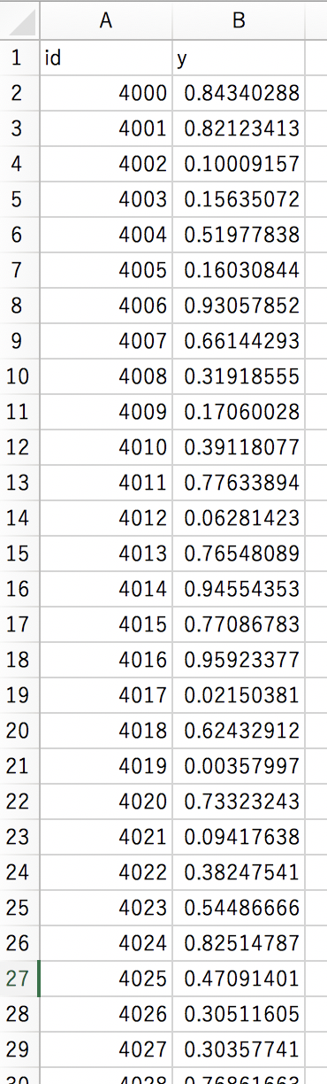


Overview of your task (2/2)
Please create and submit a file like YYMMDD_Team name.csv.
Submit date
Submission_sample.csv
(*YYMMDD_Team name*).csv
Example: 231120_Team name.csv
Input the prediction results
of your own model!
To:
Your team’s Discord channel
Please include date of submission and your team's name in the file name.
And please send to us by your group’s Discord channel

Slide 8
Tips
URL | Details
https://www.udemy.com/course/introduction-to-data-science-using-python/ | Video about outline of Data Science. Has introduction of how to use python.
https://the-algorithms.com/ | You will be acquainted with various machine learning models.
https://www.simplilearn.com/10-algorithms-machine-learning-engineers-need-to-know-article
https://github.com/Developer-Y/cs-video-courses

